Slide 1
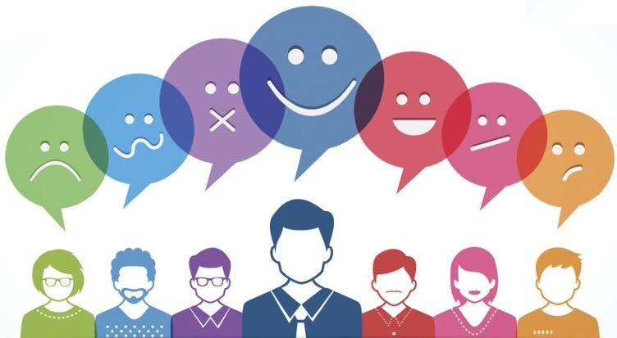

Slide 2

Understanding Twitter Sentiment on Apple and Google Products
Group 13 Members:
Amos Kipngetich
Alex Miningwa
Angela Maina
Charles Ndegwa
Gloria Tisnanga
Sandra Koech
Sylvia Manono

Slide 3




Project Overview
Business Overview
This project aims to classify Twitter sentiment about Apple and Google products to provide insights into customer satisfaction, identify issues, and guide product, marketing, and customer support strategies.
Apple and Google need to assess public sentiment to make informed decisions. By classifying tweets as positive, negative, or neutral, the goal is to understand customer feedback and improve products, marketing, and customer service.
Business Problem
The project will classify tweet sentiment about Apple and Google products to offer actionable insights for enhancing customer engagement, addressing issues, and improving brand perception.
Business Understanding
Notes:
Photo by John Schnobrich on Unsplash

Slide 4

Data Understanding
Data Columns Used
This project analyzes tweets related to Apple and Google products to classify sentiment into three categories: Positive, Negative, and Neutral. The data is sourced from Twitter, where tweets discussing popular products like the iPhone, iPad, Google Pixel, and Google Home are collected using the Twitter API. Key data columns include the tweet content, timestamp, and user details. The primary goal is to classify the sentiment of each tweet based on its content, enabling insights into customer satisfaction and potential areas for product improvement.
Tweet Content: The main text of the tweet, which is analyzed to determine sentiment.
Target brand/product labels (Apple or Google products) are crucial for building and evaluating the classifiers.
Sentiment Label: The target variable to classify tweets as Positive, Negative, or Neutral.
Data source & Product Evaluated
The dataset consists of tweets collected via Twitter's API, focusing on user opinions about various Apple and Google products.
Apple products include the iPhone, iPad, MacBook, Apple Watch, and AirPods, while Google products cover the Pixel phone, Google Home, Chromebook, and Google Assistant.
Sentiment Evaluated
Positive: Tweets showing satisfaction or praise.
Negative: Tweets expressing dissatisfaction or complaints.
Neutral: Tweets with no clear sentiment, often factual or indifferent.
03
02
01

